Slide 1
SEVIR: Storm EVent ImageRy Dataset
Mark Veillette
Nov 13th 2019
DISTRIBUTION STATEMENT A. Approved for public release: distribution unlimited.

Slide 2
This material is based upon work supported by the Federal Aviation Administration under Air Force Contract No. FA8702-15-D-0001. Any opinions, findings, conclusions or recommendations expressed in this material are those of the author(s) and do not necessarily reflect the views of the Federal Aviation Administration.
© 2020 Massachusetts Institute of Technology.
Delivered to the U.S. Government with Unlimited Rights, as defined in DFARS Part 252.227-7013 or 7014 (Feb 2014). Notwithstanding any copyright notice, U.S. Government rights in this work are defined by DFARS 252.227-7013 or DFARS 252.227-7014 as detailed above. Use of this work other than as specifically authorized by the U.S. Government may violate any copyrights that exist in this work.

Slide 3
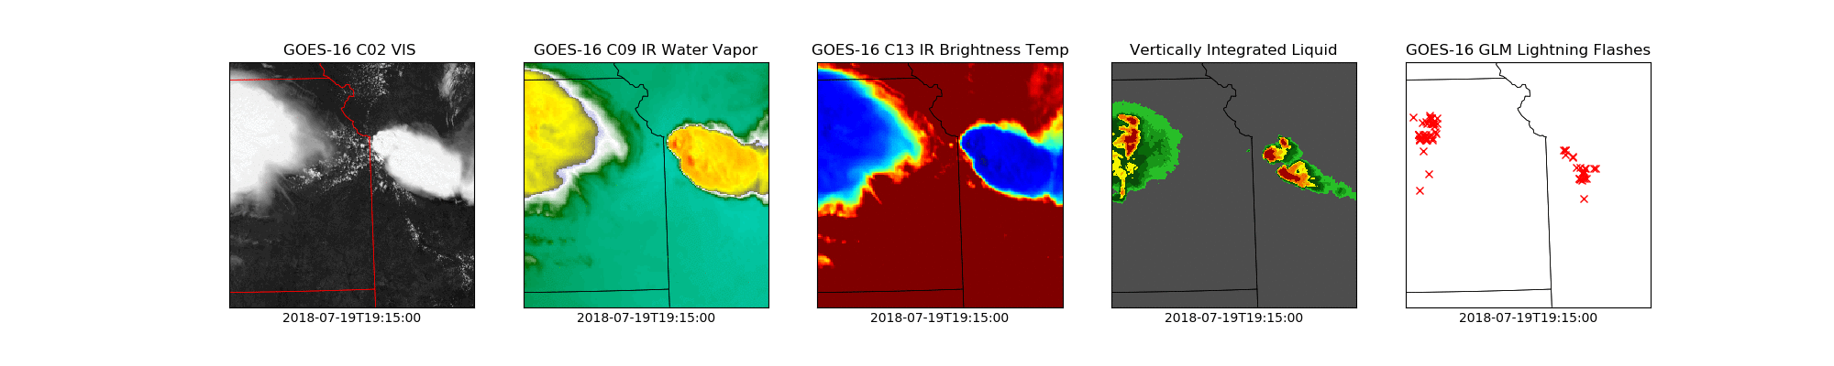
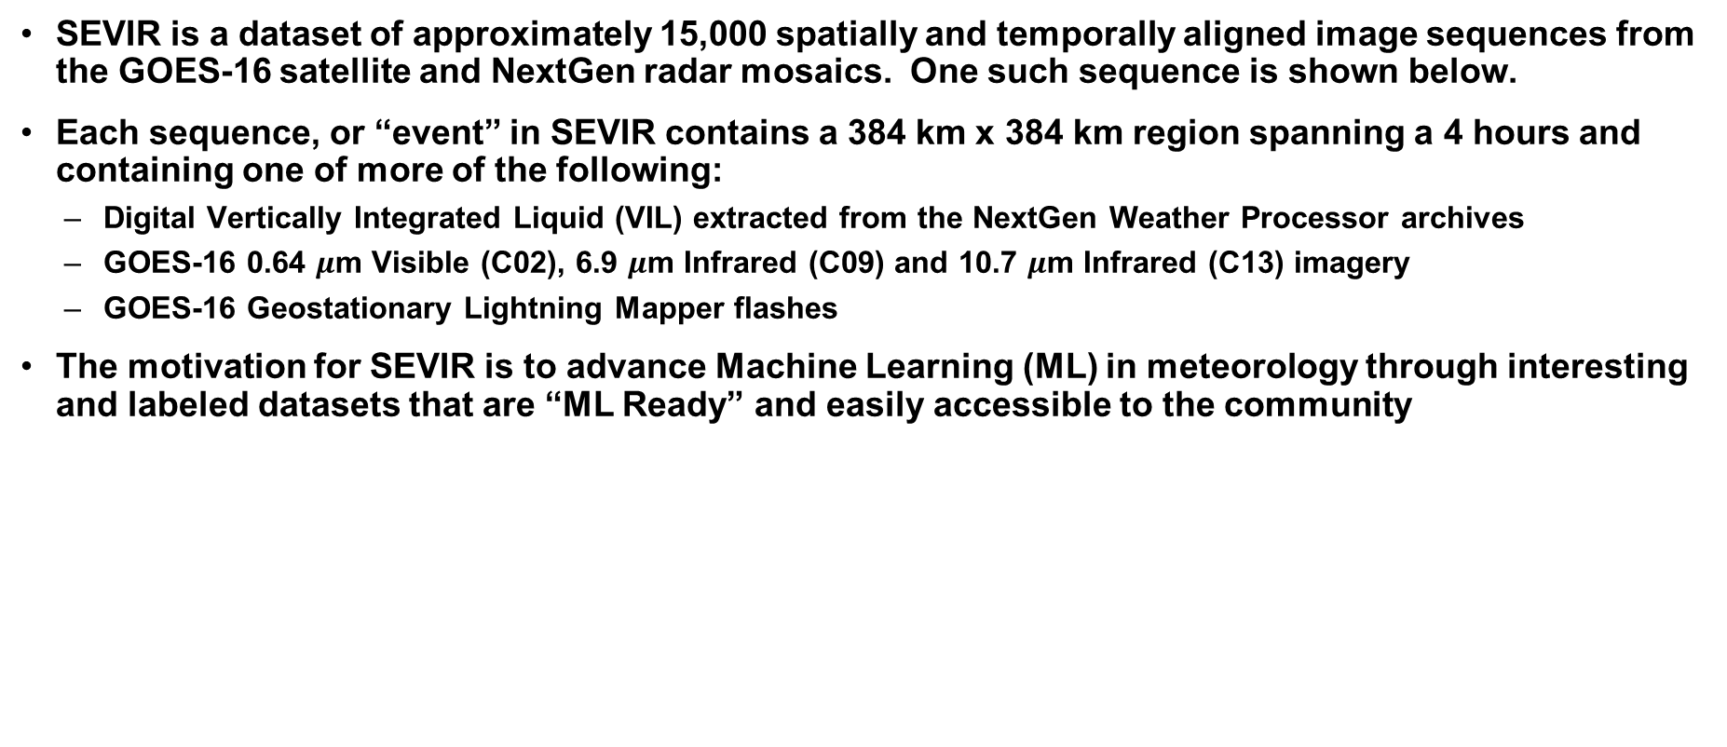
Storm EVent ImageRy (SEVIR) Dataset
SEVIR is a dataset of approximately 15,000 spatially and temporally aligned image sequences from the GOES-16 satellite and NextGen radar mosaics. One such sequence is shown below.
Each sequence, or “event” in SEVIR contains a 384 km x 384 km region spanning a 4 hours and containing one of more of the following:
Digital Vertically Integrated Liquid (VIL) extracted from the NextGen Weather Processor archives
GOES-16 0.64 $μ$m Visible (C02), 6.9 $μ$m Infrared (C09) and 10.7 $μ$m Infrared (C13) imagery
GOES-16 Geostationary Lightning Mapper flashes
The motivation for SEVIR is to advance Machine Learning (ML) in meteorology through interesting and labeled datasets that are “ML Ready” and easily accessible to the community
Sample SEVIR “Event”

Slide 4
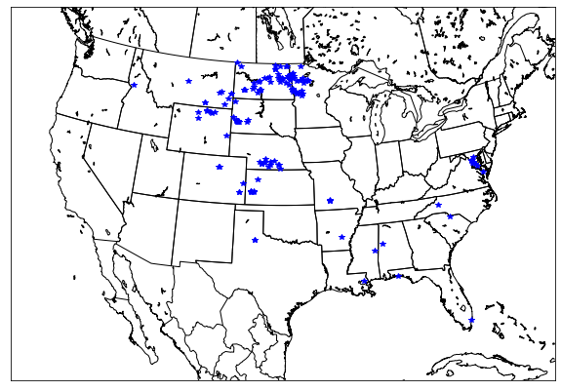
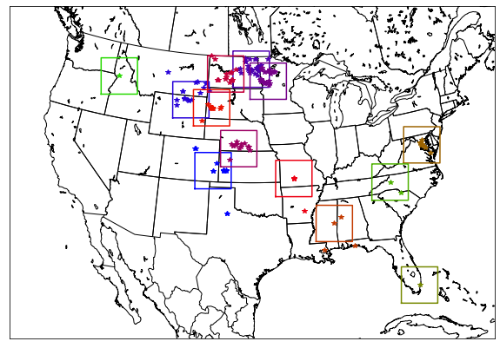
SEVIR Event Selection
SEVIR Events were chosen in one of two ways:
Based on events in NOAA’s National Centers for Environmental Information (NCEI) Storm Event Database (https://www.ncdc.noaa.gov/stormevents/)
Or, randomly chosen in areas of NEXRAD coverage over CONUS
Events listed in NCEI’s Storm event database from 2017*, 2018 & 2019 with categories Flash Flood, Flood, Hail, Heavy Rain, Lightning, Thunderstorm Wind, or Tornado were clustered based on geographical and temporal proximity
A 384 km x 384 km frame was drawn around the center of each cluster, and a 4 hour sequence of images were extracted for each case
Example Storm Event Selection (July 8th 2019)
Relevant Storm Reports on 7/8/2019
Clustered Storm Reports, with Frame Outline
*GOES-16 data only available in 2018 & 2019

Slide 5
SEVIR File Details
The SEVIR dataset consists of
107 files in HDF5 format containing imagery
Files separated by image type and date range for easier access
File sizes ranging between 1GB and 20 GB
A catalog containing meta data of each image, including
Unique ID assigned to each event
Times of each image
Lat / Lon bounds of slice
Map projection and image extent in projection coordinates for exact georeferencing
NCEI Storm Event ID and Episode ID (for non-random cases)
Total Size of SEVIR Dataset: ~900 GB

Slide 6
SEVIR Sample NCEI Event ID: 772996
Associated
NCEI
Database
Entry

Slide 7
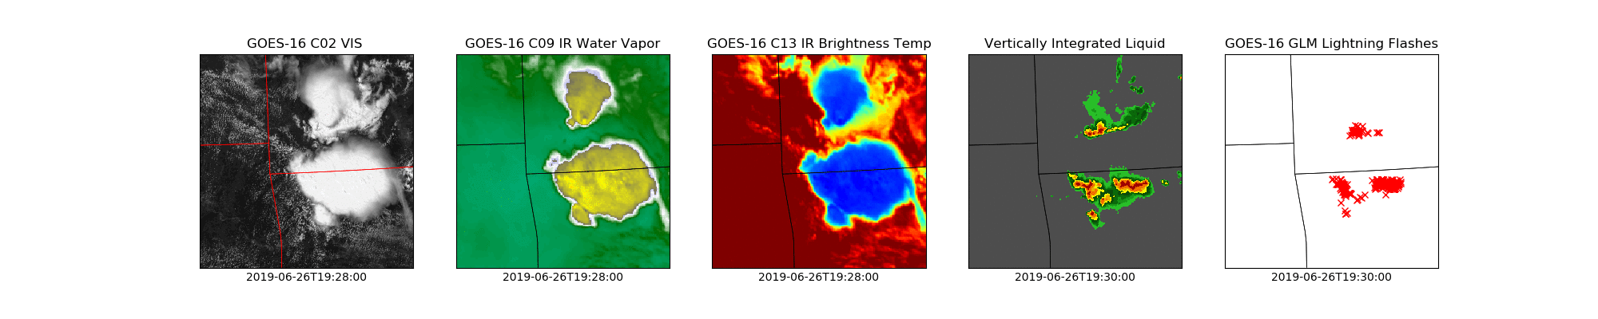
SEVIR Sample NCEI Event ID: 835047
Associated
NCEI
Database
Entry

Slide 8
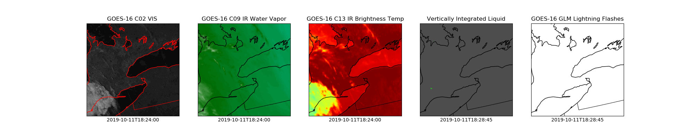
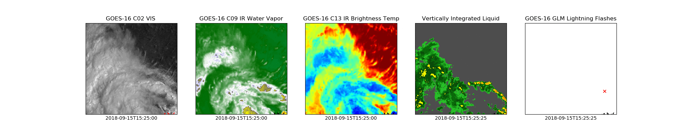
SEVIR Samples Random Events
Random Event
R19101120288358
Random Event
R18091517257459
Random Events have no associated NCEI Event ID

Slide 9
SEVIR Applications
SEVIR provides an open and reasonably sized yet statistically diverse dataset that AI and Machine learning researchers can use to improve algorithms in several research areas:
Storm object characterization
Storm tracking
Event analysis
Short-term forecasting (nowcasting)
Synthetic storm simulation
Forecast verification
Many others…
SEVIR can also be combined with other datasets, such as numerical prediction model output, to enable further capabilities

